Slide 1

Classes and Objects
2
IT 2022: Object Oriented Programming
Sandali Goonatilleke
Department of Computer Engineering

Slide 2

Module Content
Introduction to Object-Oriented Programming in C++
Classes & Objects
Constructors & Destructors
Class Abstraction and Encapsulation
Composition
Inheritance
Polymorphism

Slide 3

Overview
Define a class and use it to create an object
Implement a class’s behaviors as member functions
Implement a class’s attributes as data members
Method to call a member function of an object to perform a task
The differences between data members of a class and local variables of a function

Slide 4
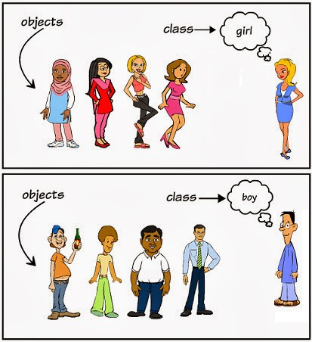
Classes and Objects

Slide 5
Class
A class combines the data and its associated functions together
It allows the data and functions to be hidden
Whenever if necessary, allow to use them externally
When designing a class, we are creating a new Abstract Data Type (ADT) that can be treated like any other built-in data type

Slide 6
Class
Classes are user-defined types
Class specification has two parts:
  Class declaration
  Class function definitions
Class declaration describe the type and scope of its members

Slide 7
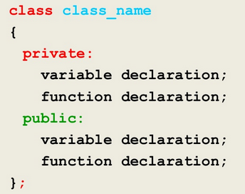
Class
The general form of class declaration

Slide 8
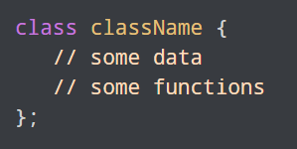
Class
A class in C++ is defined using the keyword “class” followed by the name of the class
Body of the class is defined inside the curly brackets (braces) and terminated by a semicolon at the end

Slide 9
Class
Both variables (data) and functions declared in the class body are called class members
  The variables are known as data members
  The functions are known as member functions

Slide 10
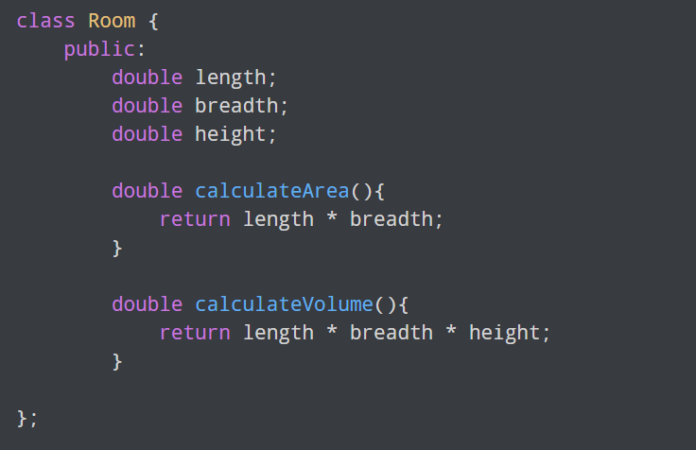
Class – Example

Slide 11
Class - Example
We defined a class named “Room”
The variables or data members are length, breadth and height
The functions and member functions are calculateArea() and calculateVolume()

Slide 12
Access Specifiers
Access specifiers define how the members (variables and functions) of a class can be accessed
In C++, there are three access specifiers
public: members are accessible from outside the class
private: members can’t be accessed from outside the class and the members are private by default
protected: members can’t be accessed from outside the class, however they can be accessed in inherited classes

Slide 13
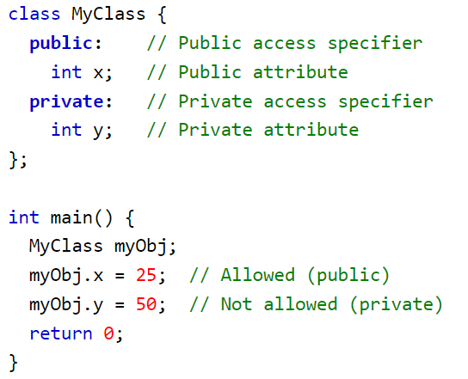
Access Specifiers – Example

Slide 14
Class Methods
Methods are functions that belongs to the class
There are two ways to define functions that belongs to a class:
- Inside class definition
- Outside class definition
In both definitions should perform the same task

Slide 15
Inside Class Definition
The definitions of the function is appeared inside the body of the class
  It is treated as inline functions
Normally, only small functions are defined inside the class definition
Small inline functions have better efficiency

Slide 16
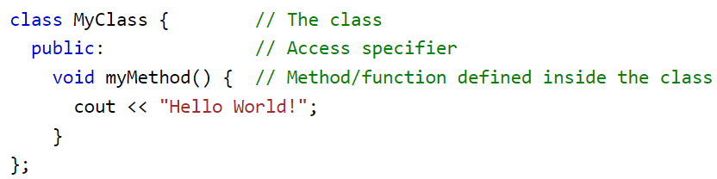
Inside Class Definition - Example

Slide 17
Outside Class Definition
First declare it inside the class and then define it outside of the class
This is done by specifying the name of the class, followed the scope resolution :: operator, followed by the name of the function

Slide 18
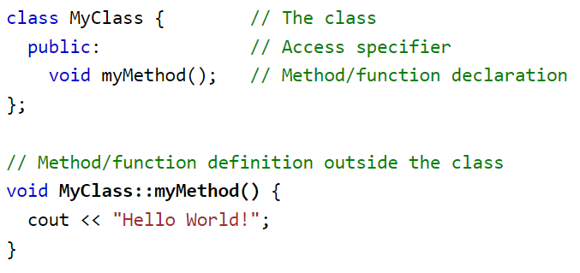
Outside Class Definition - Example

Slide 19
Objects
A class is a user defined type
An object is a variable of the class
To create an object of a class, specify the class name, followed by the object name
To access the class attributes, use the dot syntax (.) in the object

Slide 20
Objects - Example
Class name: MyClass
Object name: myObj
Variables/Attributes: myNum, myString
Functions: N/A

Slide 21
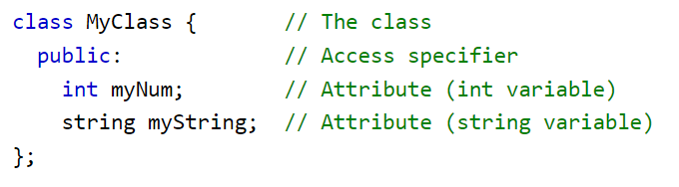
Objects - Example

Slide 22

Objects - Example

Slide 23
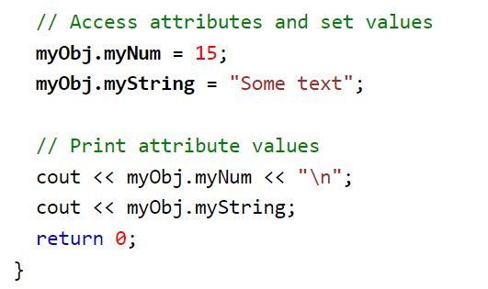
Objects - Example

Slide 24

Exercise - Homework
Define a class to interchange the values of X and Y
Member Variables
  X
  Y
Member Functions
  getData
  setData
  swapValues

Slide 25
Thank You!

